Slide 1

SFWRENG 4HC3 6HC3 /COMPSCI 4HC3 Human Computer Interfaces Lab 3: Personas and Scenarios
SFWRENG 4HC3 6HC3 | COMPSCI 4HC3 Danny Papagiannis
Acknowledgement: Parts of these lectures are based on material prepared by 3M, Andrew Maxwell, IDEO, and open source material from the Internet

Slide 2
WELCOME BACK!!

Slide 3

Design Theme: Safety on Campus
https://ugdsbisp.com/wp-content/uploads/2017/01/McMaster-University.jpg
https://ugdsbisp.com/wp-content/uploads/2017/01/McMaster-University.jpg

Slide 4

Problem Solving With The A-Team
https://images2.minutemediacdn.com/image/upload/c_crop,h_358,w_640,x_0,y_12/f_auto,q_auto,w_1100/v1555924029/shape/mentalfloss/a-team_1.jpg

Slide 5
Problem Solving with the A-Team
The A-Team is on vacation and will return after reading week

Slide 6
Personas and Scenarios: In-class
1. Try to interview at least 2 people from another group in your class. Ask them about safety on campus (15 mins)
2. Go back into your groups. Review your notes. Develop a persona which describes a member of a primary stakeholder group for a solution to assist with safety on campus based on the people that you have interviewed (15 mins)
3. Using your persona write a story scenario about a task related to safety on campus (15 mins)
-Time permitting, draw a storyboard of 6-12 shots showing your persona going through this task
4. Time permitting, present your findings to the class and also post in the discussion board on Avenue (10 mins)

Slide 7
Personas and Scenarios: Online
1. In a group of 4-5, watch the 3 videos from different universities regarding crime on campus. Assume that they are McMaster students. Takes notes of whatever catches your attention
https://www.youtube.com/watch?v=JWTeJzzDbOA
https://www.youtube.com/watch?v=Zwgs7y0sbrw
https://www.youtube.com/watch?v=xQA65A04LnA
(6 mins)

Slide 8
Personas and Scenarios: Online
2. Review your notes. Develop a persona based on these videos which describes a member of a primary stakeholder group for a solution to assist with safety on campus (15 mins)
3. Using your persona write a story scenario about a task related to safety on campus (10 mins)
-Time permitting, draw a storyboard of 6-12 shots showing your persona going through this task
4. Time permitting, present your findings to the class and also post in the discussion board on Avenue (15 mins)

Slide 9
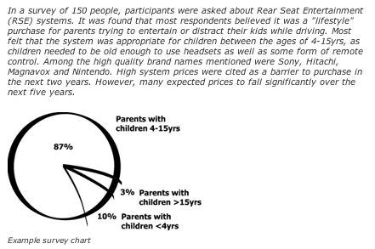
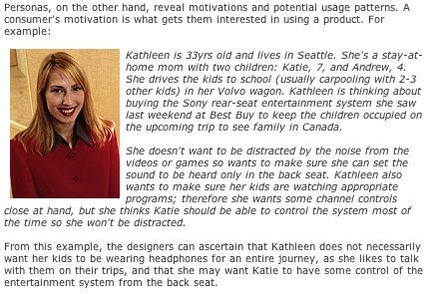
Market Segmentation & Personas
Source: www.cooper.com/ newsletters/2002_02

Slide 10
Types of Scenarios
Stories are the real-world experiences of people.
Conceptual scenarios are more abstract descriptions in which some details have been stripped away.
Concrete scenarios are generated from abstract scenarios by adding specific design decisions and technologies and once completed these can be represented as use cases.
Use cases are formal descriptions that can be given to programmers.

Slide 11
Story Scenario
I needed to make an appointment for Kirsty, my little one. It wasn’t urgent – she had been having a lot of bad ear-ache every time she had a cold – but I did want to see Dr. Fox since she’s so good with the children. And of course ideally it had to be when Kirsty was out of school and I could take time off work. I rang the surgery and the receptionist told me that the next appointment for Dr. Fox was the next Tuesday afternoon. That was no good since Tuesday is one of my really busy days so I asked when the next one was. The receptionist said Thursday morning. That meant making Kirsty late for school but I agreed because they sounded very busy – the other phone kept ringing in the background – and I was in a hurry myself. It was difficult to suggest a better time without knowing which appointments were still free.

